Slide 1
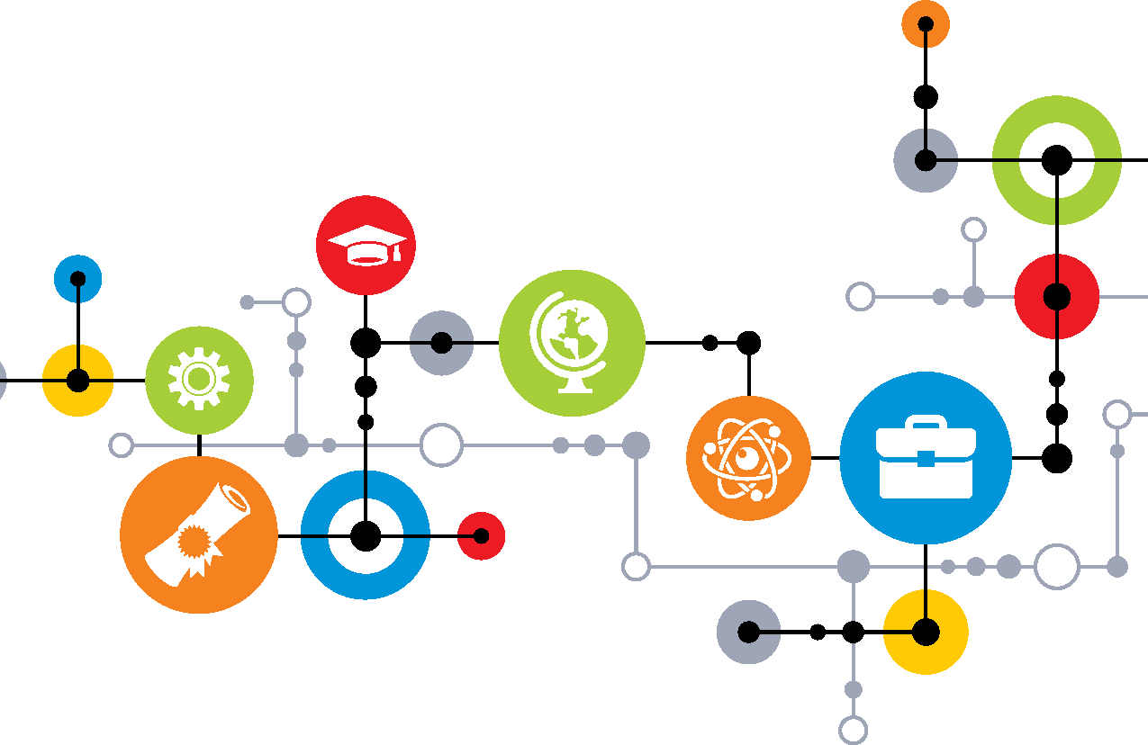
Talent Pipeline Management

Slide 2
Goals
Introduce USCCF and our work focused on closing the skills
Familiarize you with the tools, resources, and supports available
Engage with one another on the possibility of implementing this approach within your industry sector

Slide 3
America’s Skill Gap
Our education and workforce system is failing to keep pace with our economy
Employers struggle with finding skilled workers who can contribute to economic growth and competitiveness
Disconnect between what employers need and what prospective employees are prepared to do
Status quo contributes to high unemployment/underemployment, growing entitlements, and lost opportunities for growing the middle class.

Slide 4
America’s Skill Gap – By the Numbers
Executives believe there is a serious gap in workforce skills: 92%
Employers struggling to fill vacant jobs: 49%
Growth of skills gap by 2020: 6 million unfilled positions.
Employers believe college grads are prepared for the workforce: 11% vs. 96% (CAO)
Planning to hire recent graduates: 65% (up from 57%)
Sources: Adecco; Accenture; Manufacturing Institute; Georgetown Center on Education and the Workforce.

Slide 5
America’s Skill Gap – By the Numbers
Forgone revenue per unfilled position: $23,000
Mid-size manufacturers loss in annual earnings: 11% ($4.6 million)
Fail to achieve key financial targets: 43%
Reduced ability to innovate: 40%
Unable to start a major project or strategic initiative: 37%
Sources: CareerBuilder; Accenture and Manufacturing Institute; Chartered Global Management Accountant.

Slide 6
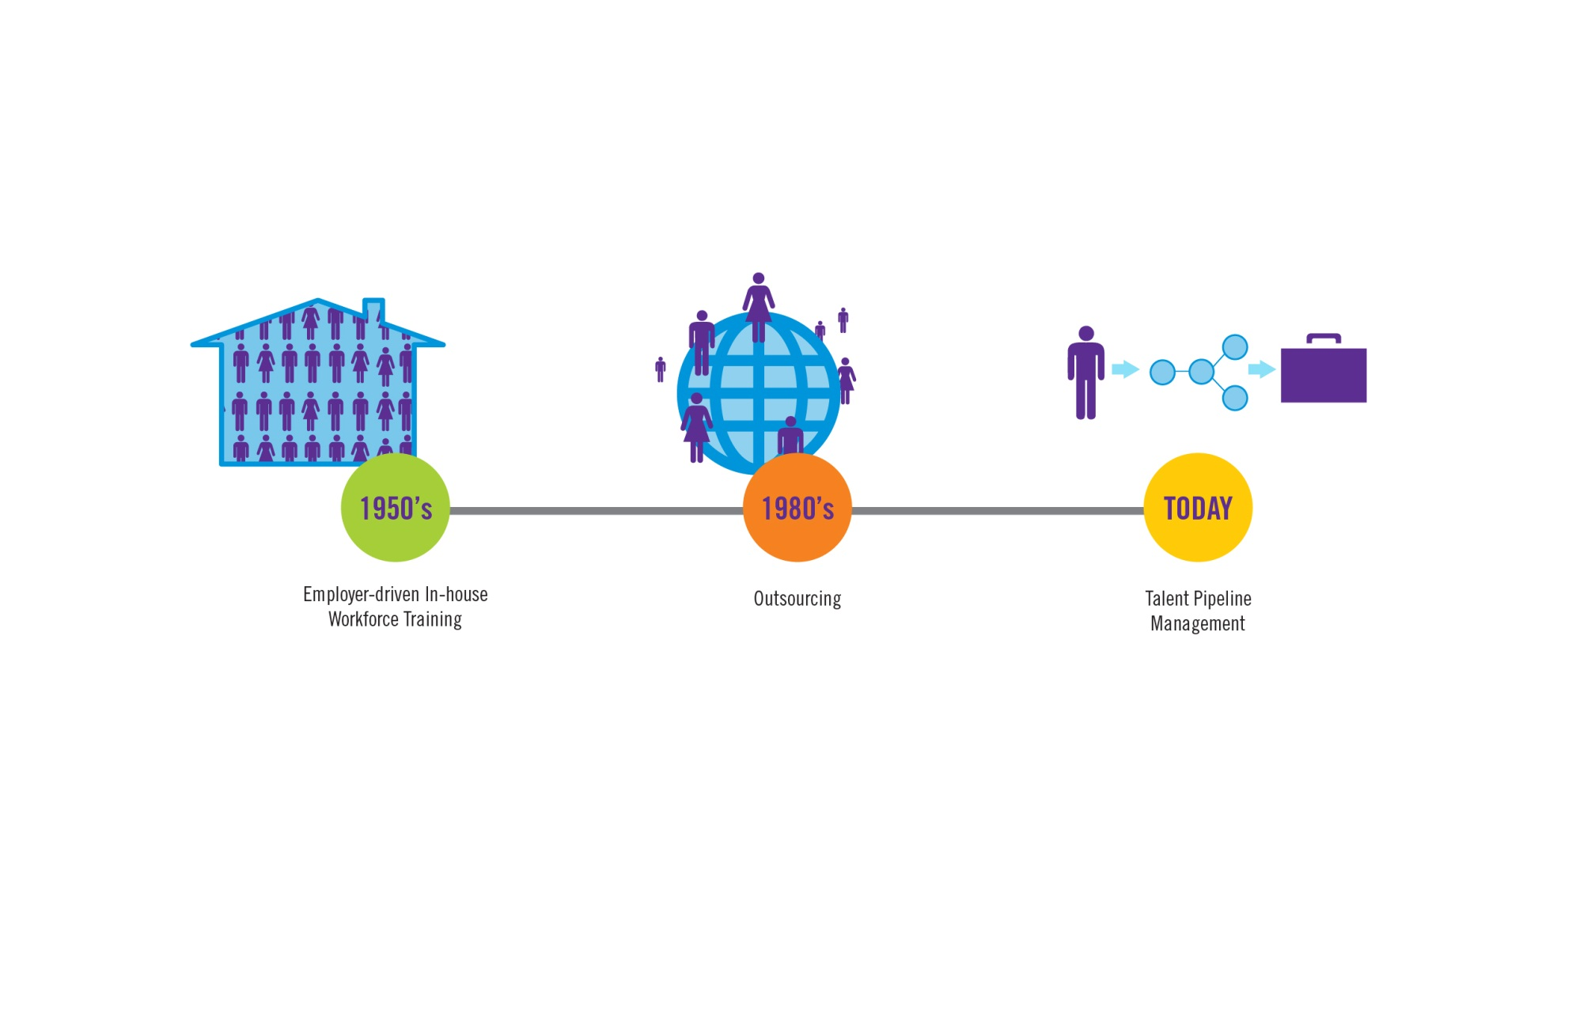
Strategy for Our Time

Slide 7
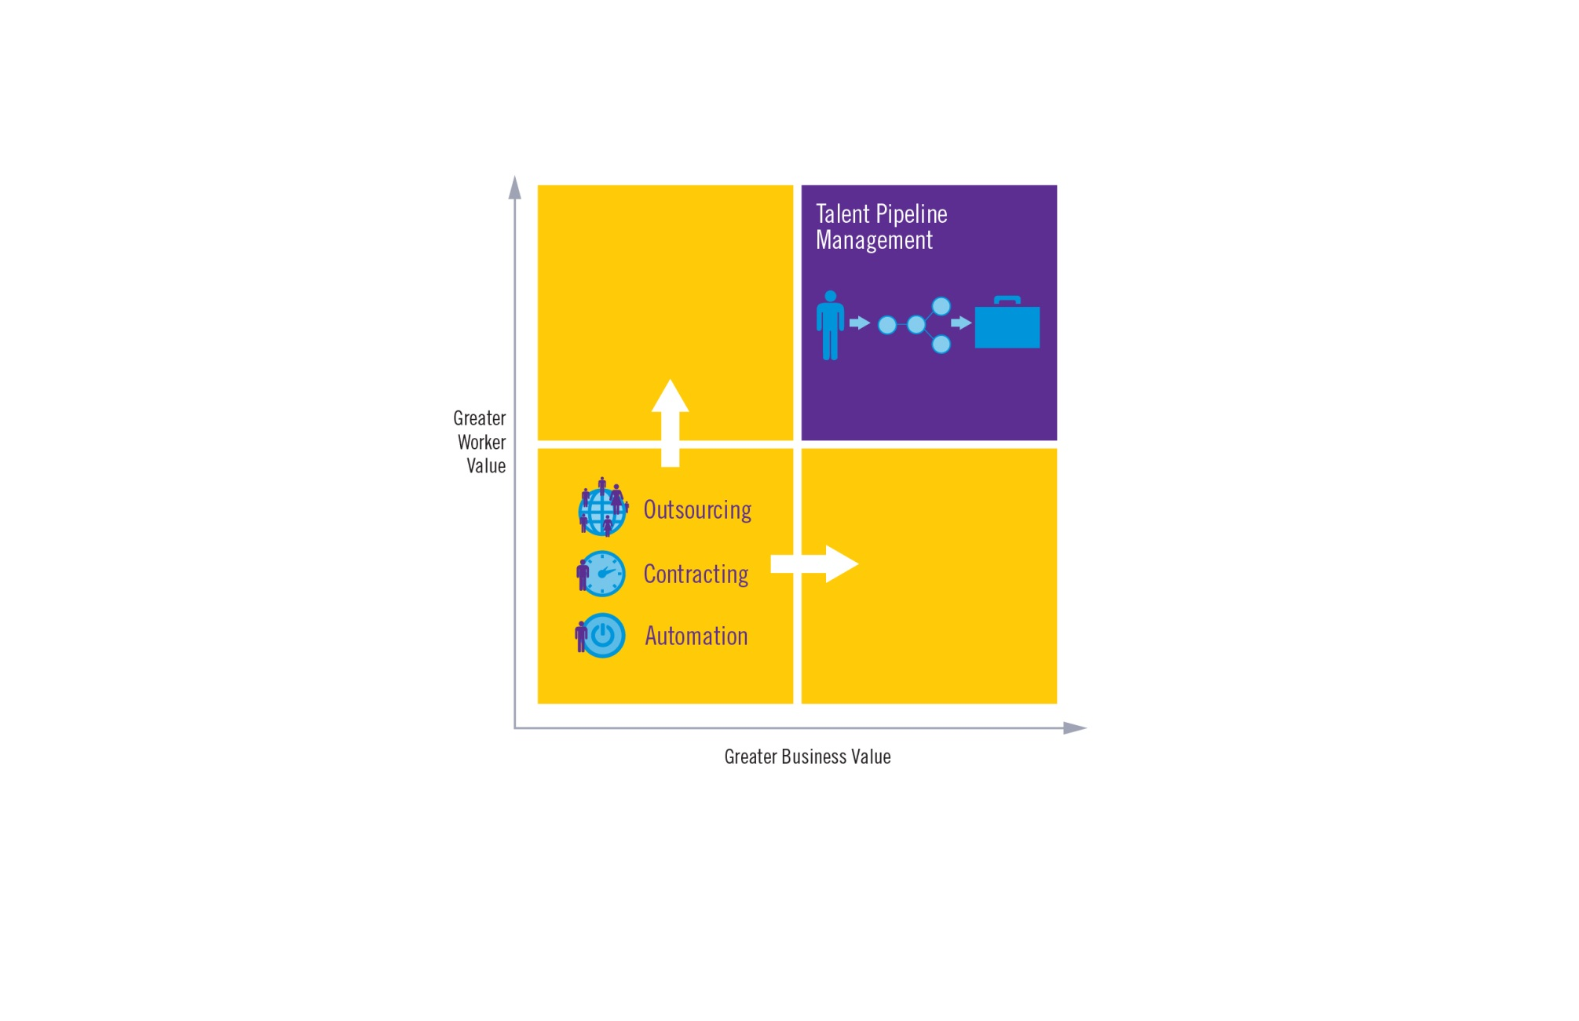
Career Value vs. Business Value

Slide 8
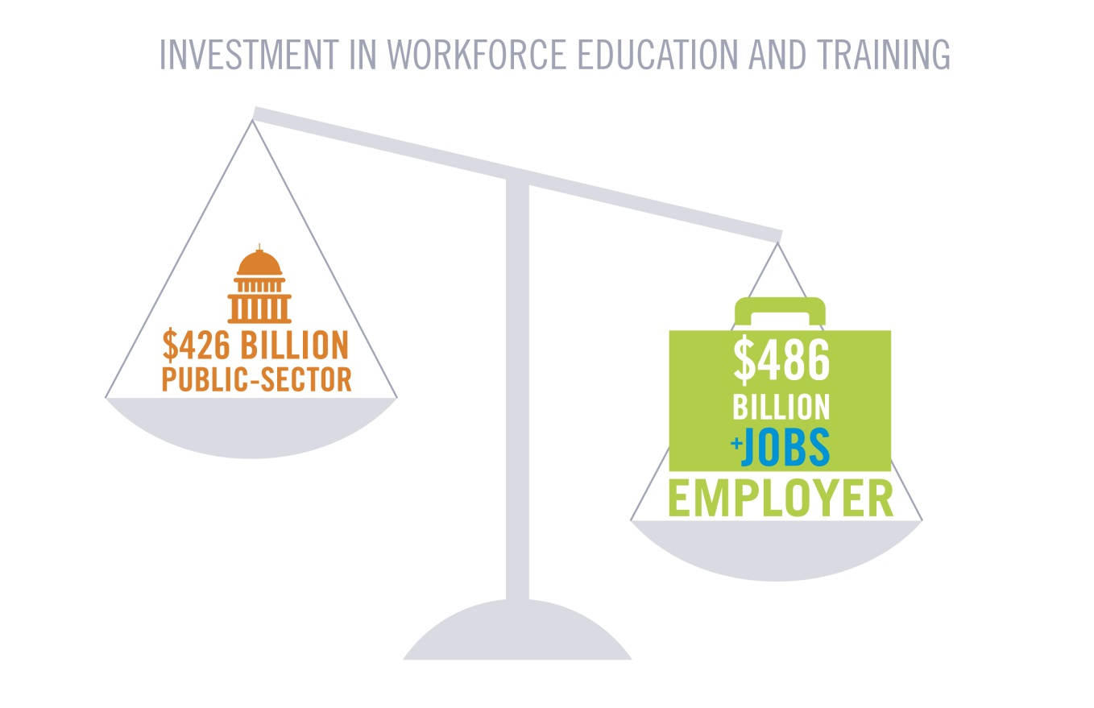
Employer Investment

Slide 9
Moving to a Supply Chain Approach
Employers can close the skills gap by applying lessons learned from supply chain management (SCM) to their education and workforce partners.
Raw Materials
Supplier
Manufacturer
Distributor
Retailer
Customer

Slide 10
Lessons Learned from Supply Chain Management
Principles
Supply Chain Management | Talent Pipeline Management
1. Supply chains drive competitive advantage, they are not a cost of doing business | 1. Connect your talent strategy to your business strategy to improve competitiveness
2. Supply chain networks create shared value and competitiveness across all partners | 2. Organize and manage flexible and responsive partnerships with preferred providers to create shared value
3. End-to-end metrics and aligned incentives improve performance across the supply chain | 3. Shared measures and aligned incentives improve performance of education and workforce partners

Slide 11
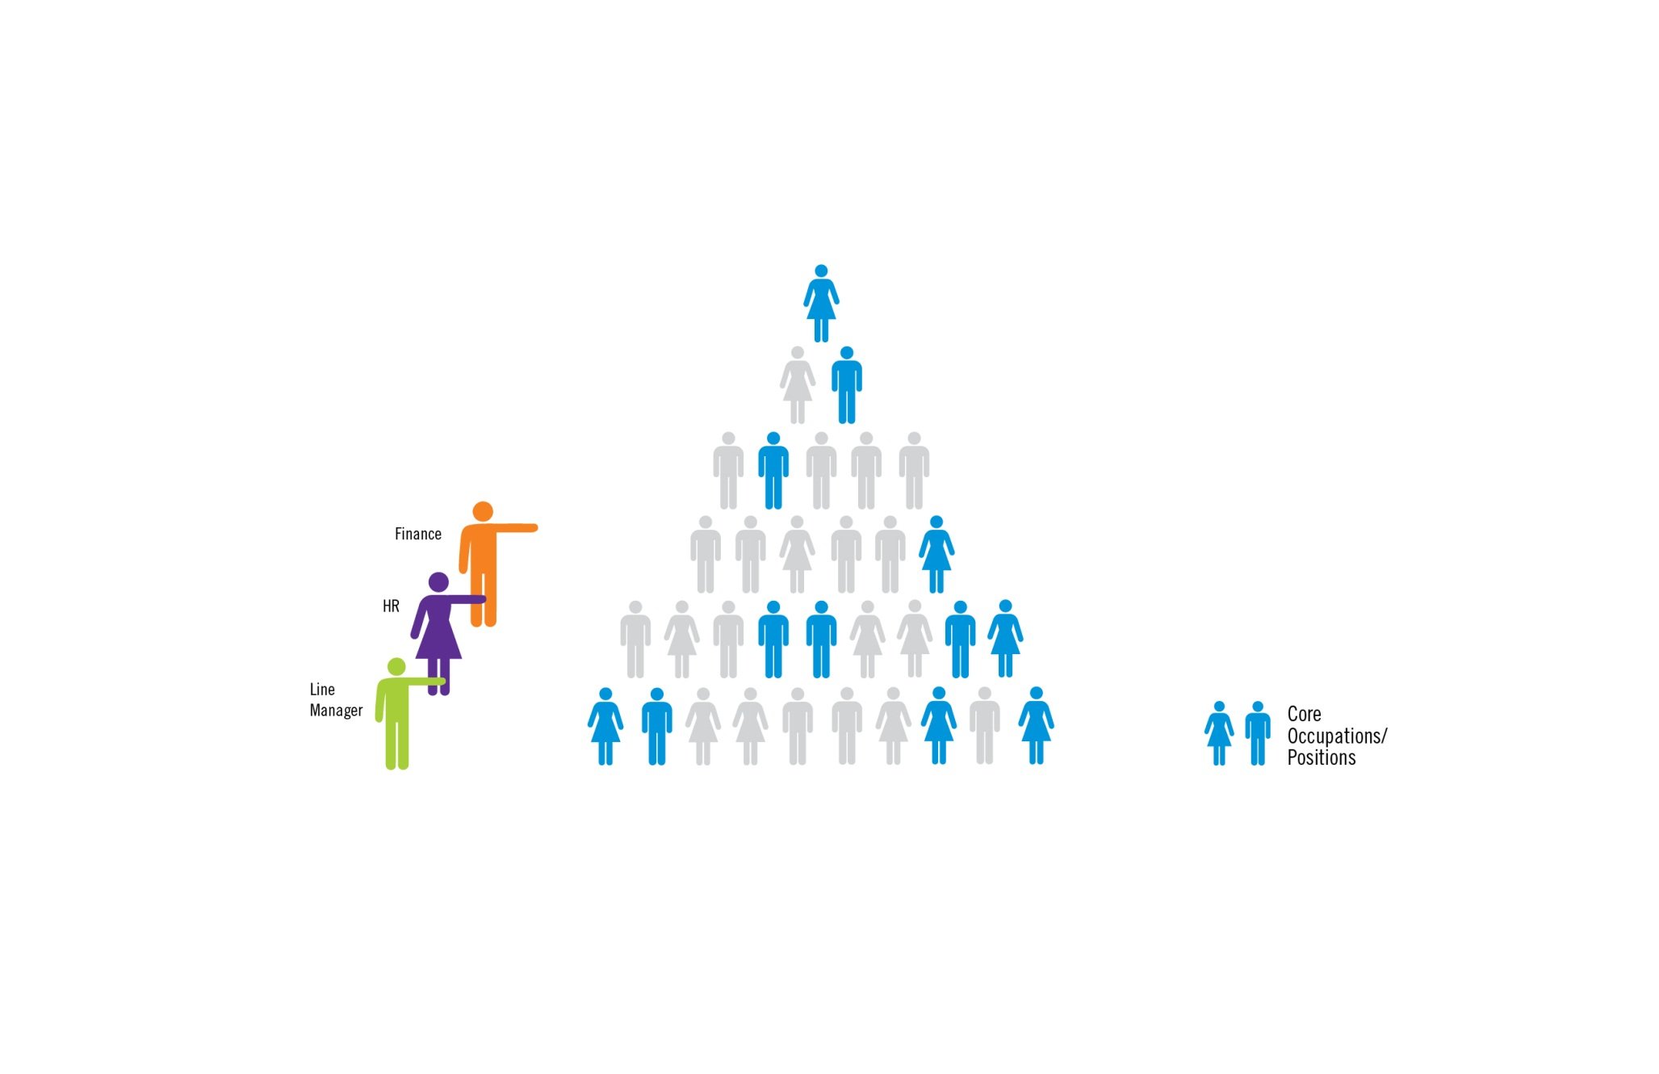
Core Capabilities

Slide 12
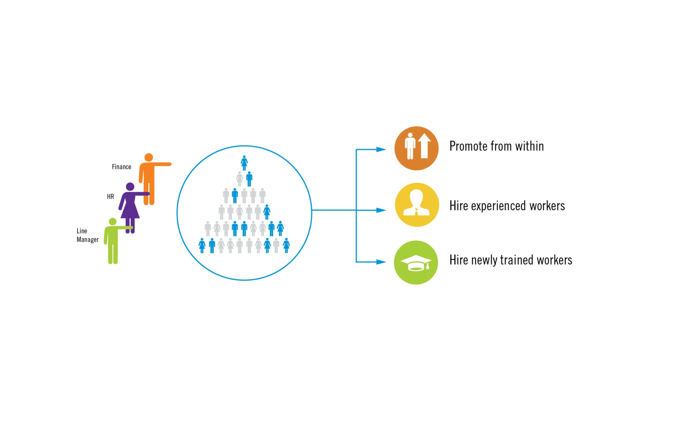
Workforce Segmentation

Slide 13
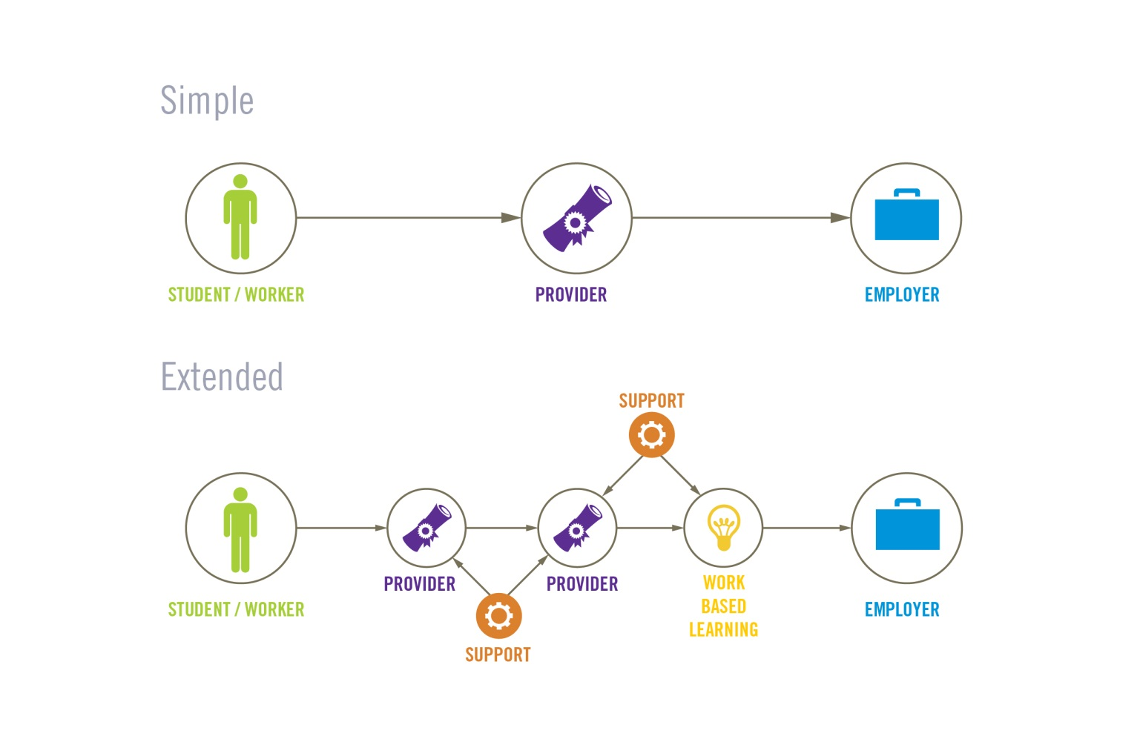
Simple vs. Extended Value Chains

Slide 14
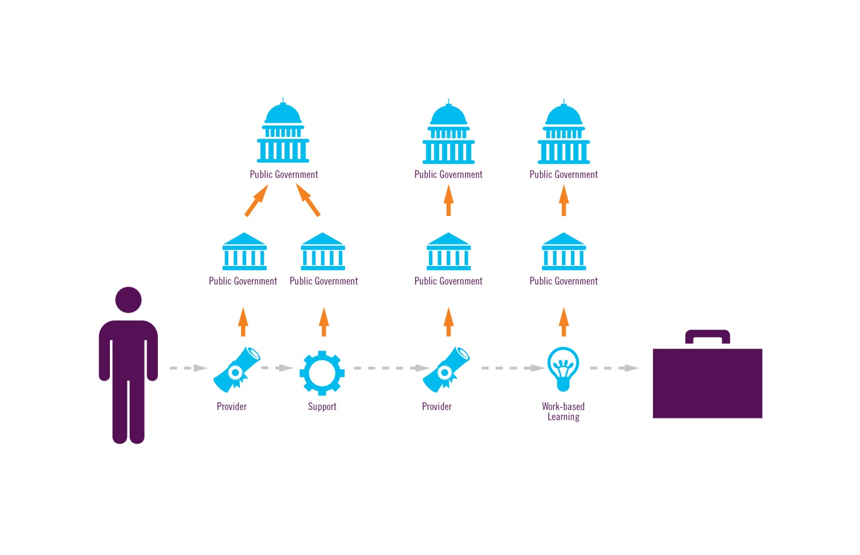
Silo Measures

Slide 15
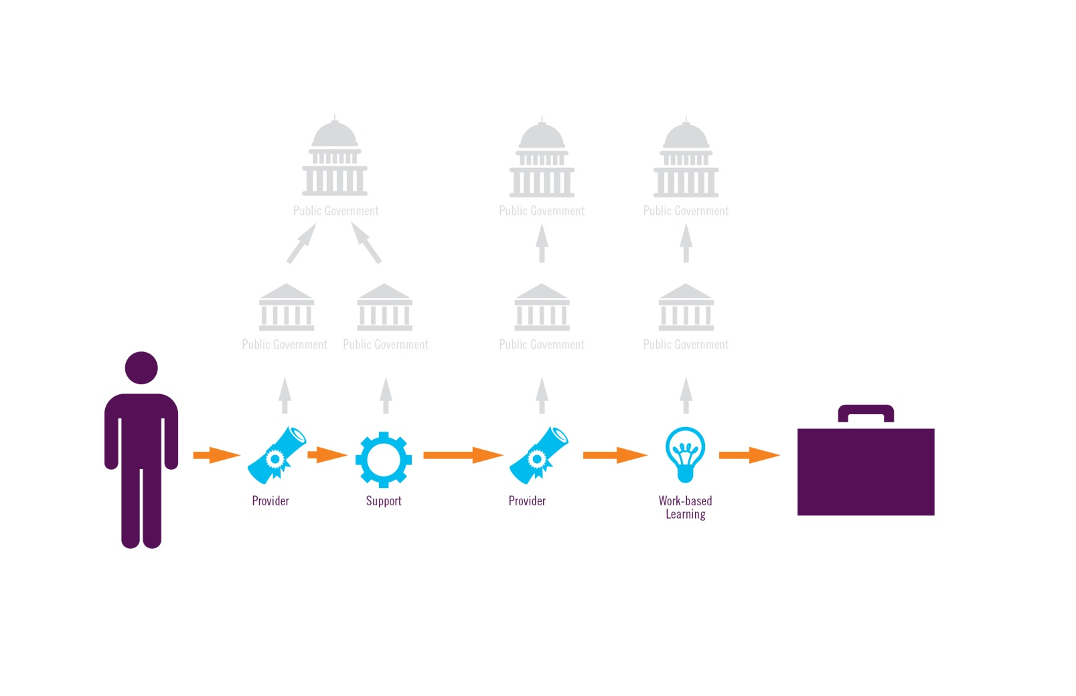
End-to-End Performance

Slide 16
Balanced Measures

Slide 17
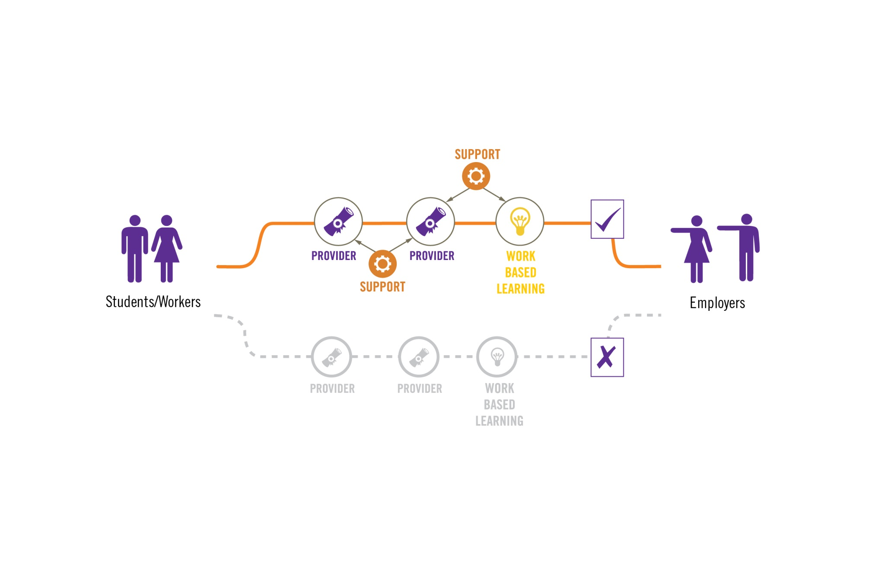
Promote Preferred Providers

Slide 18
The Talent SCM Approach – Stakeholder Implications
Will employers play the role of the end-customer?
What are the major implications for education and workforce partners?
Can students and workers get a better ROI from talent supply chains?
How does this approach change the role of government?

Slide 19
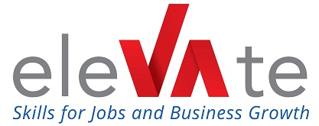
The National Learning Network

Slide 20
Strategy 1: Organize Employer Collaboratives
Implementation Guide Strategies
Strategy 4: Analyze Talent Flows
Strategy 2: Engage in Demand Planning
Strategy 5: Implement Shared Performance Measures
Strategy 3: Communicate Competency and Credential Requirements
Strategy 6: Align Incentives

Slide 21
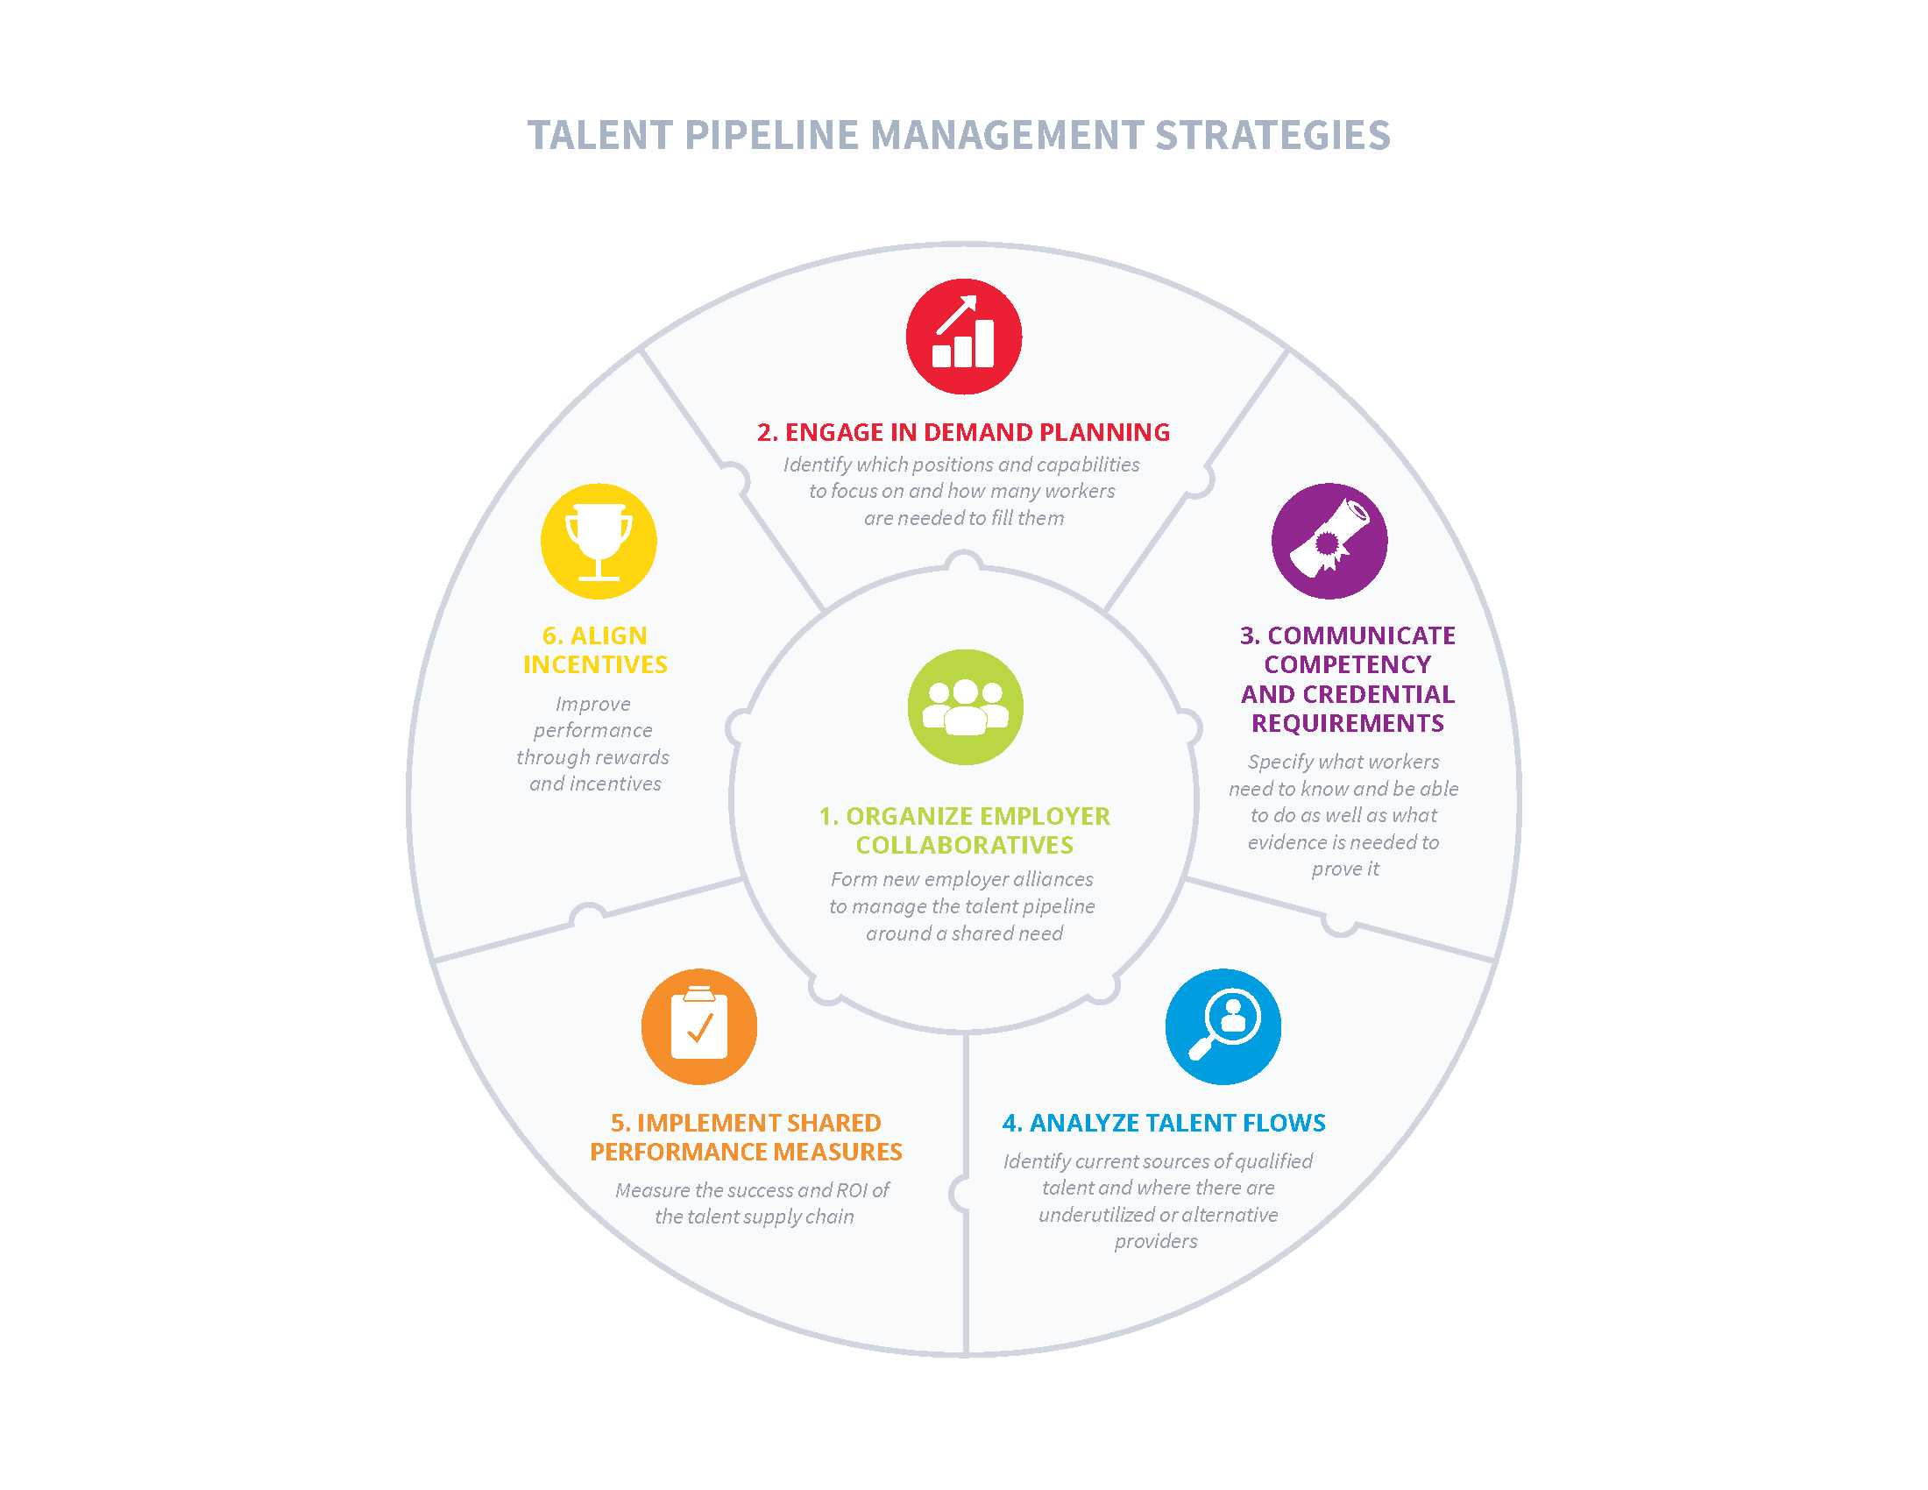
Coordinated Approach
Notes:
Strategies
Supply Chain Management
Talent Pipeline Management
Joint Sourcing – Improve market leverage as a group and achieve economies of scale in sourcing and purchasing of products and services
1. Organize Employer Collaboratives – Form new employer alliances to manage the talent pipeline around a shared need
Plan – Forecast demand for products and services
2. Engage in Demand Planning – Identify which positions and capabilities to focus on and how many workers are needed to fill them
Develop Sourcing Requirements – Develop specifications for products and services that are included in procurement
3. Communicate Competency and Credential Requirements – Specify what workers need to know and be able to do as well as what evidence is needed to prove it
Develop Sourcing Networks – Develop supply chain networks for supplying products and services based on sourcing requirements
4. Analyze Talent Flows – Identify current sources of qualified talent and where there are underutilized or alternative providers
Manage and Improve – Manage and improve the making, delivery, and returns of procured products and services from sourcing networks
5 & 6. Implement Shared Performance Measures and Align Incentives – Measure the success and ROI of the talent supply chain, and improve performance through rewards and incentives

Slide 22
Mapping the Value Stream

Slide 23
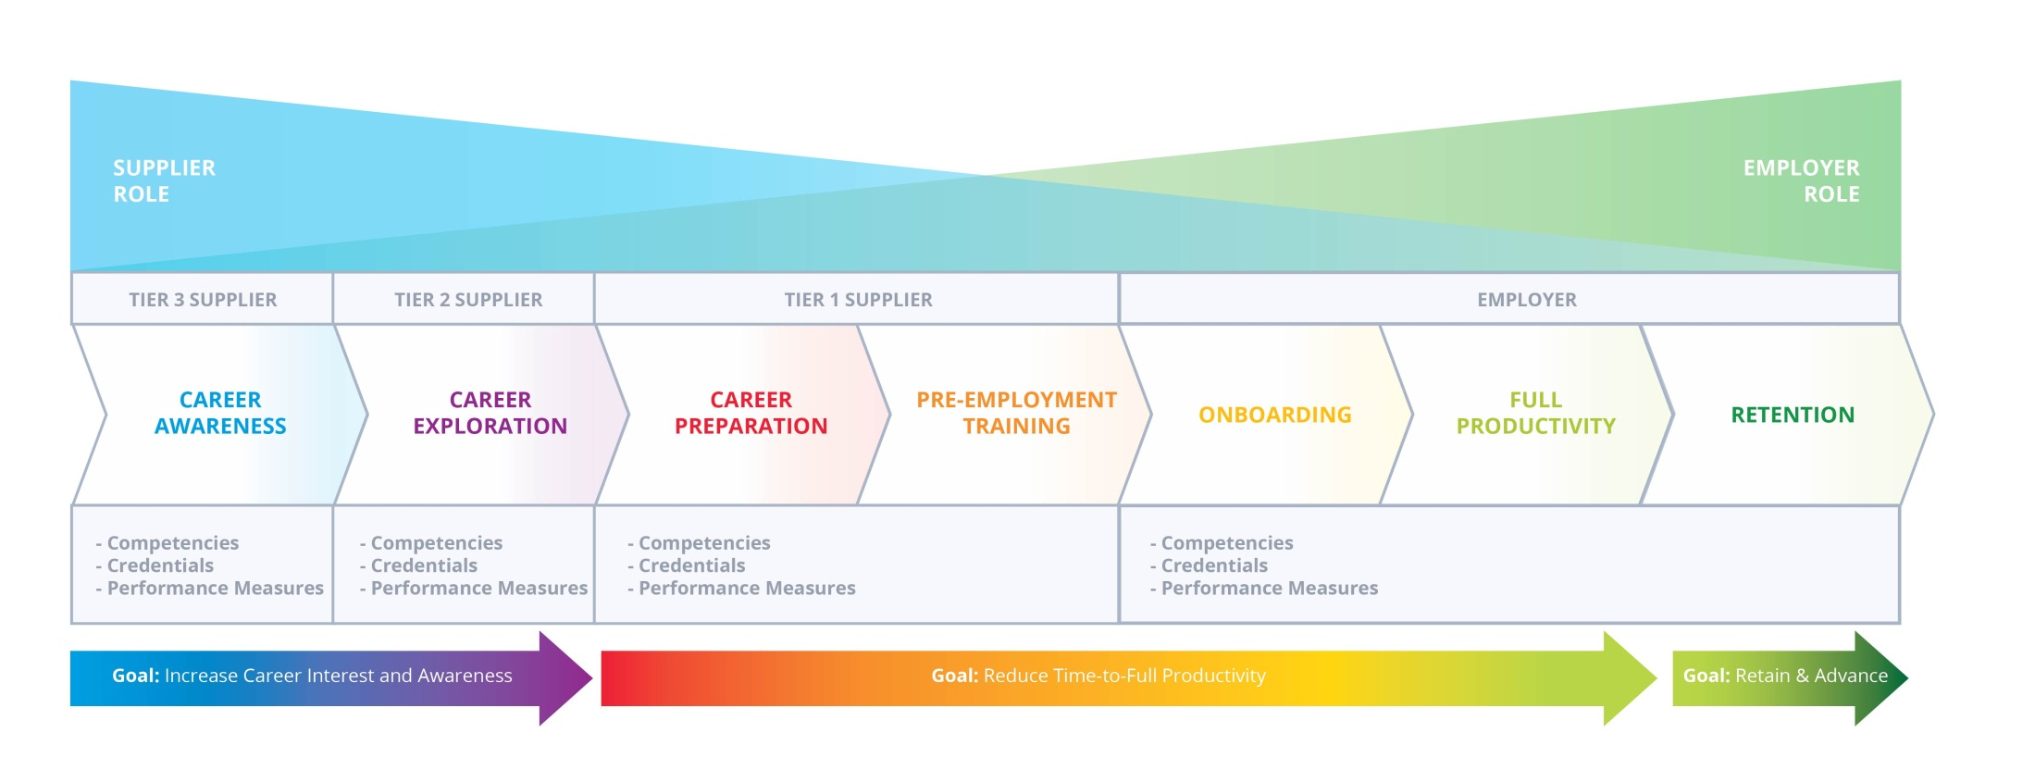
Mapping the Value Stream (continued)

Slide 24
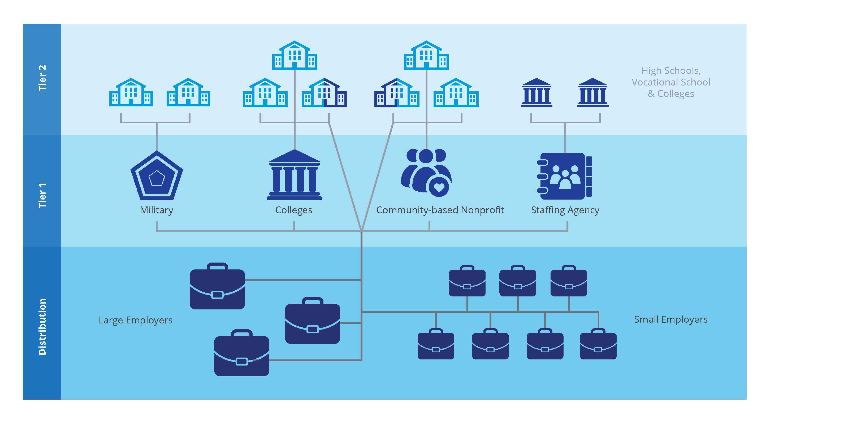
Analyzing Talent Flows

Slide 25
Performance Dashboard Example

Slide 26
Employer Quality Assurance Layers
Employer
Employer
Level 3
Employers & Collaboratives
Employer
Employer
Employer Collaborative
Employer
Employer
Level 2
Industry Associations
Level 1
National Business Associations

Slide 27
Employer Quality Assurance – Principles & Requirements
Principle | Level 1 Requirements | Level 2 Requirements | Level 3 Requirements
End-Customer Focus | National business associations e.g., U.S. Chamber of Commerce and Business Roundtable | National or regional industry associations e.g., National Association of Manufacturers and Center for Energy Workforce Development | Local chambers of commerce, economic development organizations, or employers e.g., Vermilion Advantage or Alcoa
Managing Customer Requirements | Common employability skills e.g., teamwork, problem solving, and communication | Level 1 plus industry-specific competencies and credentials e.g., machining and NIMS | Level 2 plus more specific competencies, credentials and other hiring requirements e.g., security clearances
Performance Management and Continuous Improvement | Basic supplier effectiveness measures e.g., completion rates, program duration, cost, and employment and earnings | Level 1 plus integration with certification data held by third party organizations e.g., certification organizations | Level 2 plus integration with applicant tracking systems and HRIS e.g., hires, retention, time-to-full productivity, time-to-career advancement

Slide 28
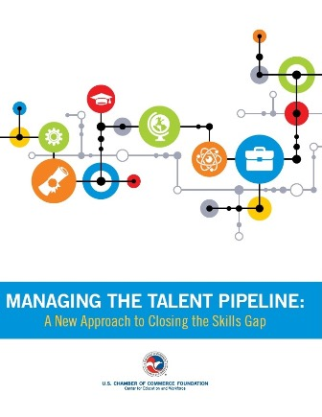
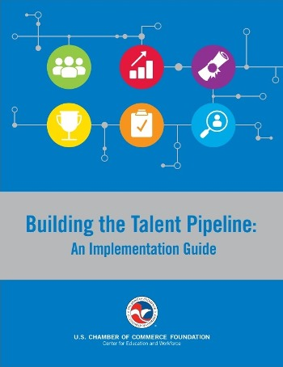
www.TheTalentSupplyChain.org

Slide 29
Discussion Questions
Where would you start and which employers are ready?
Can this approach add value to industry-led efforts underway today?
What are the major barriers or challenges and what supports are needed?
What are the remaining questions and issues that need to be addressed?

Slide 30
Thank You to Our Sponsor
“Completion with a purpose”

Slide 31
Jason A. Tyszko
Senior Director, Policy & Programs
jtyszko@uschamber.com

